Slide 1
MODULE 2
Systems Analysis Skills

Slide 2
Role of System Analyst
The system analyst is a person who is thoroughly aware of the system and guides the system development project by giving proper directions.
He is an expert having technical and interpersonal skills to carry out development tasks required at each phase.
Main Roles
Defining and understanding the requirement of user through various Fact finding techniques.
Prioritizing the requirements by obtaining user agreement.
Gathering the facts or information and acquires the opinions of users.
Maintains analysis and evaluation to arrive at appropriate system which is more user friendly.
Suggests many flexible alternative solutions, pick the best solution, and quantify cost and benefits.
Draw certain specifications which are easily understood by users and programmer in precise and detailed form.

Slide 3
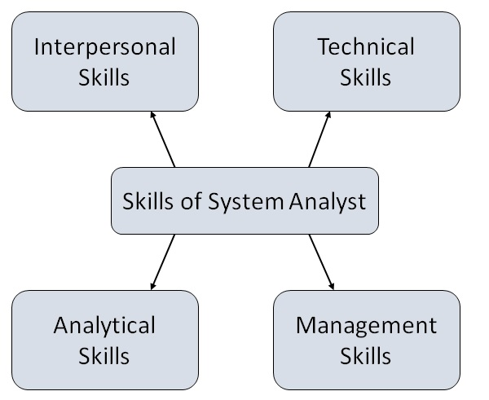
Attributes of a Systems Analyst
The following figure shows the attributes a systems analyst should possess

Slide 4
Attributes of a Systems Analyst
Interpersonal Skills
Interface with users and programmer.
Facilitate groups and lead smaller teams. Collaborating with team members, facilitating group discussions,
Managing expectations of stakeholders throughout the project lifecycle.
Good understanding, communication, selling and teaching abilities. Clear and effective communication, both verbal and written, to convey technical information to various stakeholders.
Conducting interviews, actively listening to stakeholders, and utilizing questionnaires to gather relevant information and requirements.
Creating and delivering compelling presentations to convey technical concepts, project updates, or system designs to diverse audiences.
Motivator having the confidence to solve queries.

Slide 5
Attributes of a Systems Analyst
Analytical Skills
System study. The ability to view a system holistically, understanding how individual components interact and impact each other.
Organizational knowledge. Understanding the organizational structure, goals, and processes to align information systems with business objectives.
Problem identification, problem analysis, and problem solving. Recognizing issues, challenges, or opportunities within the organization that can be addressed through information systems.
The capacity to analyze complex problems systematically and devise effective solutions that meet business requirements.
Sound commonsense
Ability to access trade-off
Curiosity to learn about new organization

Slide 6
Attributes of a Systems Analyst
Management Skills
Understand users jargon and practices.
Resource management. Efficiently allocating and managing resources, including human resources, time, and budget, to ensure project success.
Project management. The ability to plan, execute, and oversee projects, including defining scope, managing tasks, and ensuring deliverables are met on time and within budget.
Change management. Guiding the organization through changes introduced by the implementation of new information systems, ensuring a smooth transition and user adaptation.
Risk management. Identifying and mitigating potential risks that may impact the success of a project or the functionality of the system.
Understand the management functions thoroughly.

Slide 7
Attributes of a Systems Analyst
Technical Skills
Knowledge of computers and software. Familiarity with relevant tools and software used in systems analysis, such as modeling tools, project management tools, and version control systems.
Keep abreast of modern development.
Know of system design tools.
Breadth knowledge about new technologies.
Proficiency in designing and managing databases, including data modeling and database normalization.
Understanding of Systems Development Life Cycle (SDLC). Knowledge of the phases involved in system development, from requirements gathering to implementation and maintenance
Programming and Scripting. Depending on the role, familiarity with programming languages and scripting may be necessary for system implementation and integration.
Proficiency in designing and managing databases, including data modeling and database normalization.

